Slide 1
The challenge:
Asset pricing:“bubbles” “fire sales” “liquidity spirals” “segmented markets”
Corporate/macro: “financing/capital constraints”

Slide 2
Segmented markets
Security class
Security class
?
Investor
Investor
Investor
Investor
Investor
Intermediated markets
Security class
Intermediary
Intermediary
?
“Equity”
“Debt”
“Equity”
“Debt”
Investor
Investor
Investor
Investor
Other assets
Other assets

Slide 3
Bubbles:
Definitions and facts

Slide 6
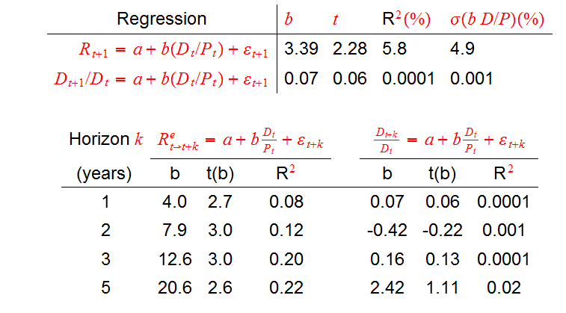

Slide 7
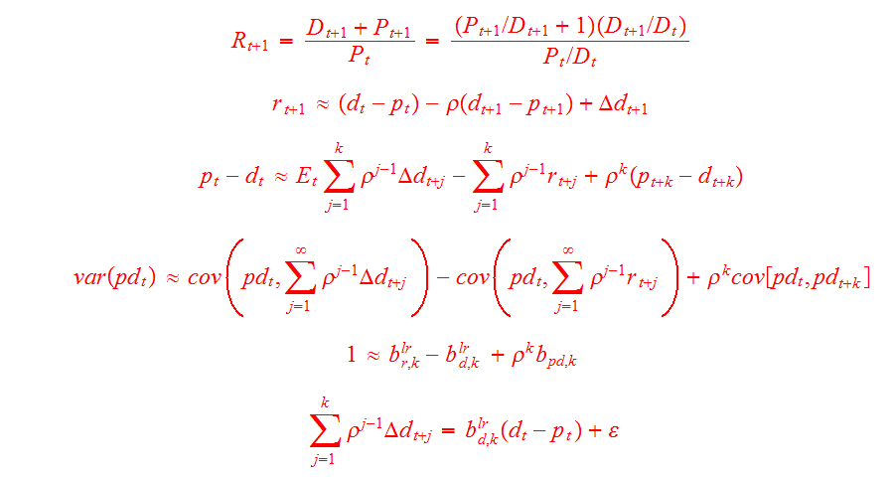

Slide 8


Slide 10
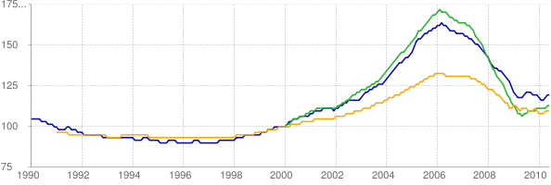
Home Price-to-Rent: First American, Case-Shiller, FHFA
http://www.deptofnumbers.com/affordability/us/

Slide 11
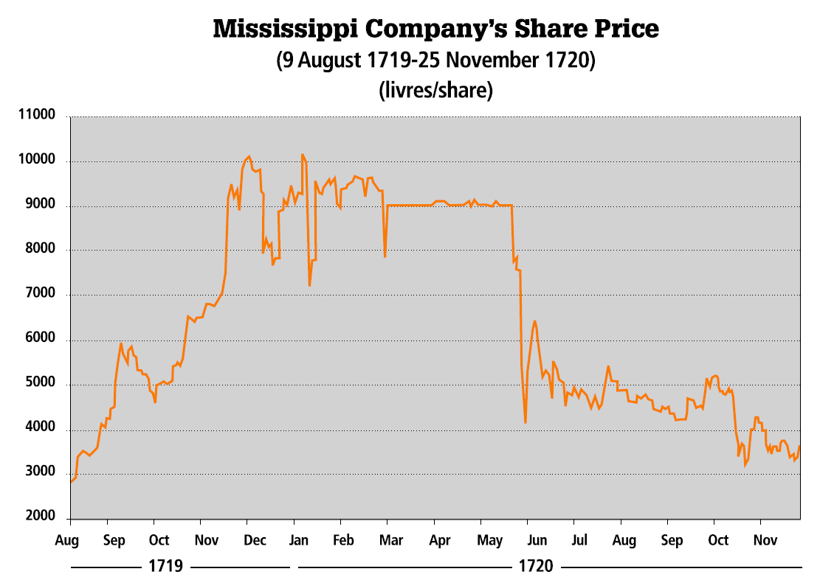

Slide 12
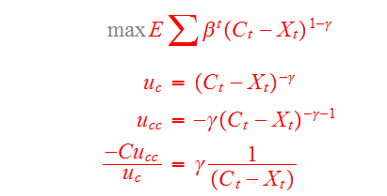
Frictionless macro asset pricing:
A useful benchmark or a hopeless anachronism?
1. Consumption
Habits are one model of time-varying risk premium
2. Investment
I/k=f(Q)

Slide 16
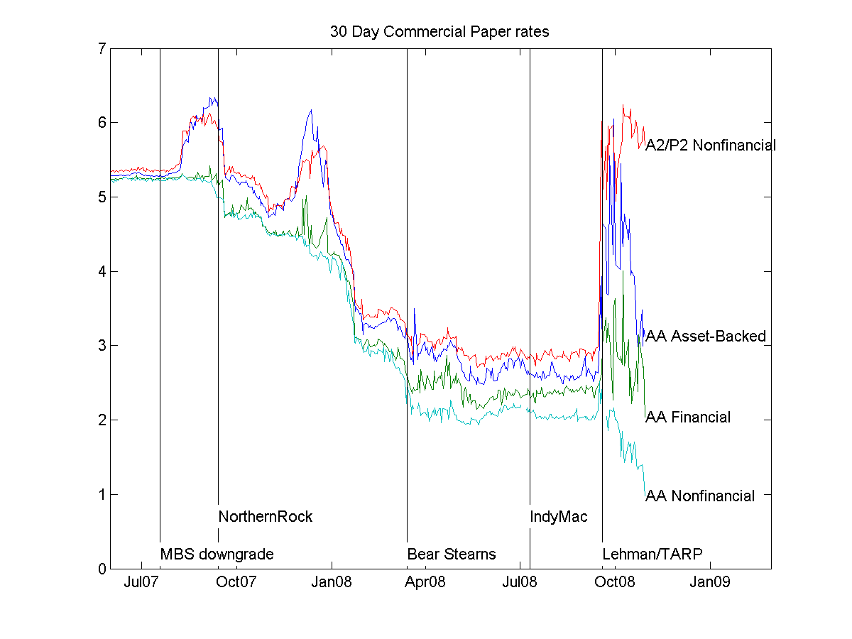
AA nonfinancial fine. “dysfunctional market” or “credit risk premium”

Slide 17
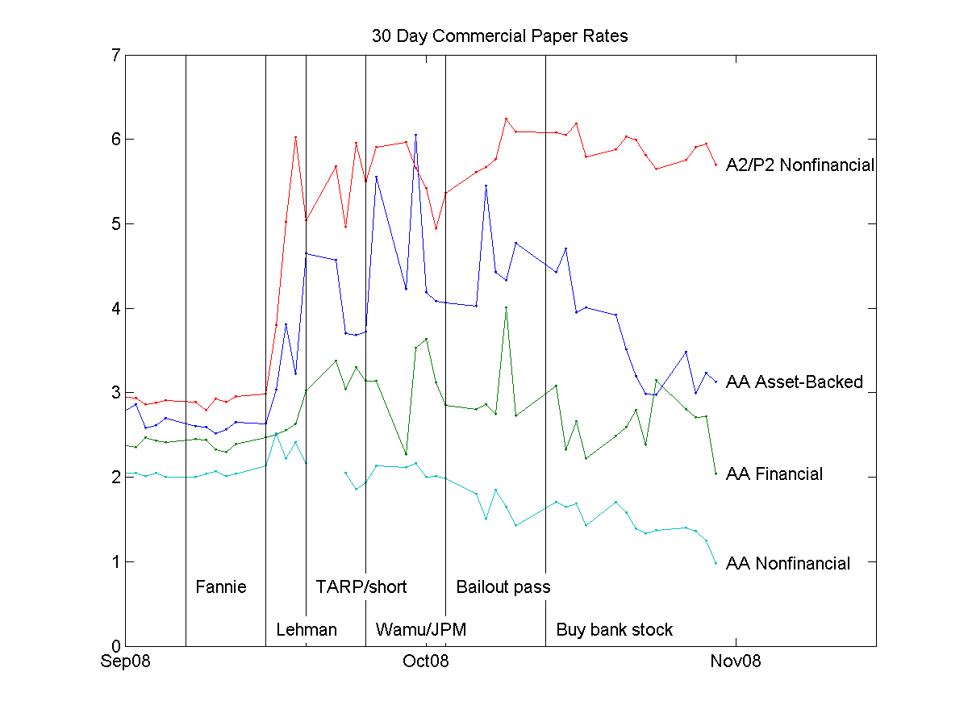

Slide 19
“Arbitrage”
The cake, or the frosting?

Slide 20
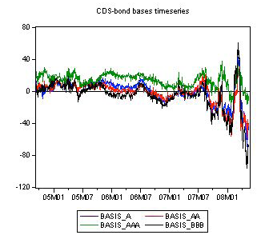
Source: Fontana (2010)

Slide 21
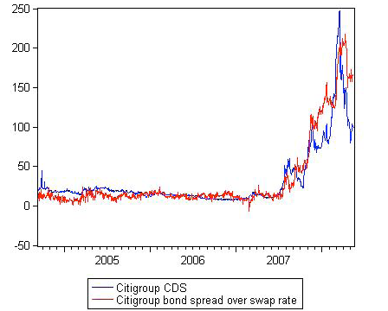
Source: Fontana 2010

Slide 22
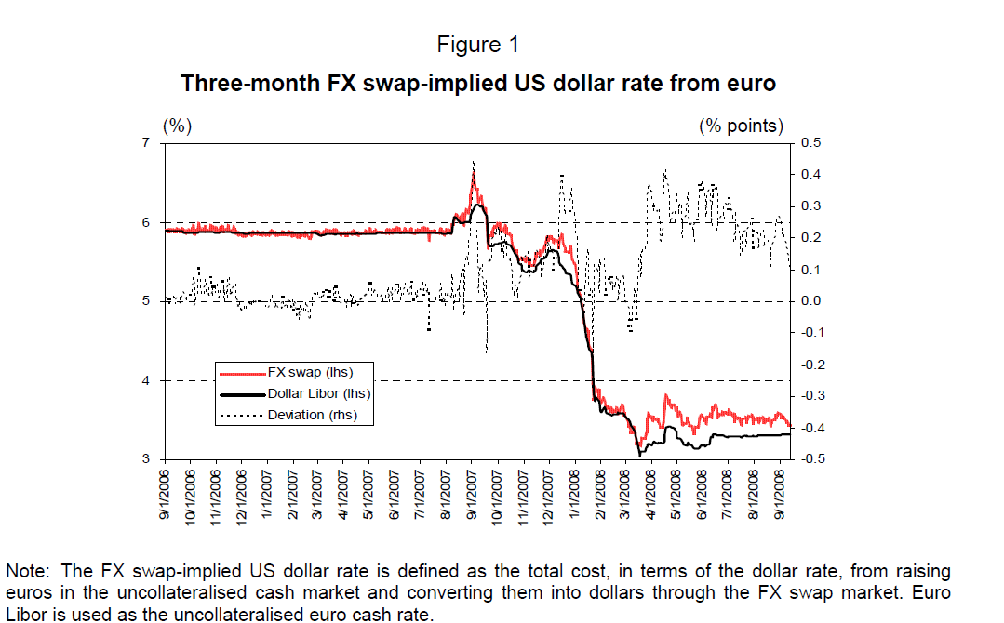
Source: Baba and Packer 2008

Slide 25
Banks, credit channel, financial frictions

Slide 26

A credit crunch: Banking system cannot make new loans.
Interest
rate
Supply (savings)
System
Doesn’t
Work
Demand (investment, mortgages)
Loans
Capital requirement

Slide 27
View 3: Investor Fear + Recession
Interest
rate
Supply
Of risky debt
Demand
Loans
A fall in loans need not mean a credit crunch

Slide 28
Flow of new lending
r
r
Loan
Loan
Broken intermediary system?
Banks or securitized debt markets?
Higher risk aversion, less demand?
Banks or securitized debt markets?
Borrowing Does Decline, a lot! Flow of funds ($billion)
 | Mortgage | Consumer | Business | Federal | Financial
06/Q1 | 1184 | 65 | 862 | 310 | 1379
07/Q1 | 769 | 120 | 983 | 267 | 1493
08/Q1 | 251 | 120 | 763 | 412 | 872
08/Q2 | -32 | 101 | 628 | 310 | 941
08/Q3 | -241 | 38 | 451 | 2078 | 1126
08/Q4 | -163 | -83 | 185 | 2155 | 1222

Slide 29
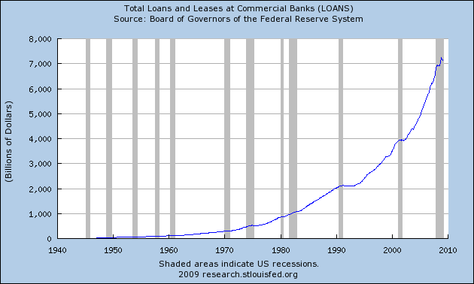

Slide 30
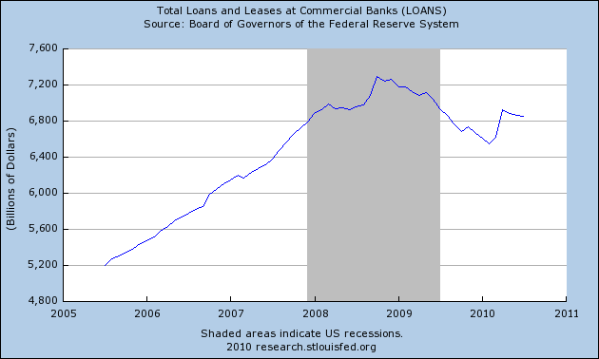

Slide 31
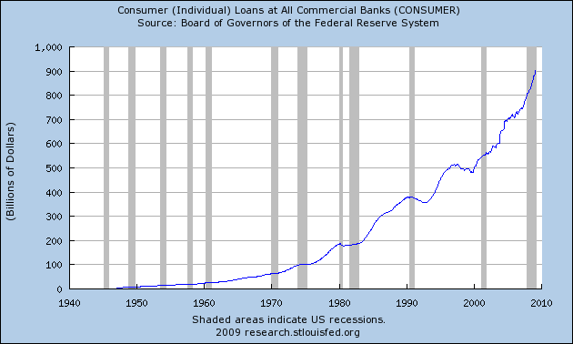

Slide 32


Slide 33
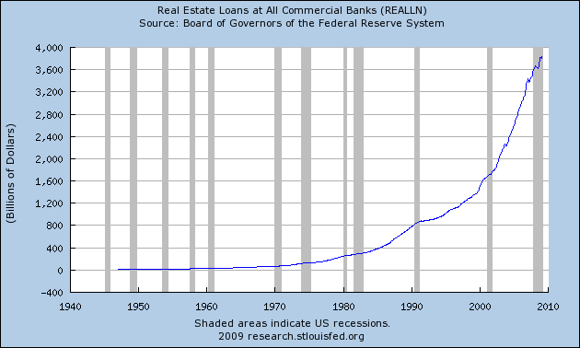

Slide 34
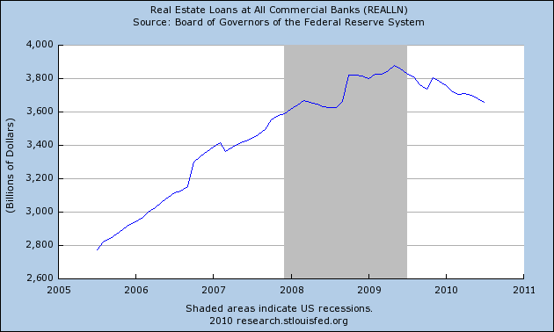

Slide 35
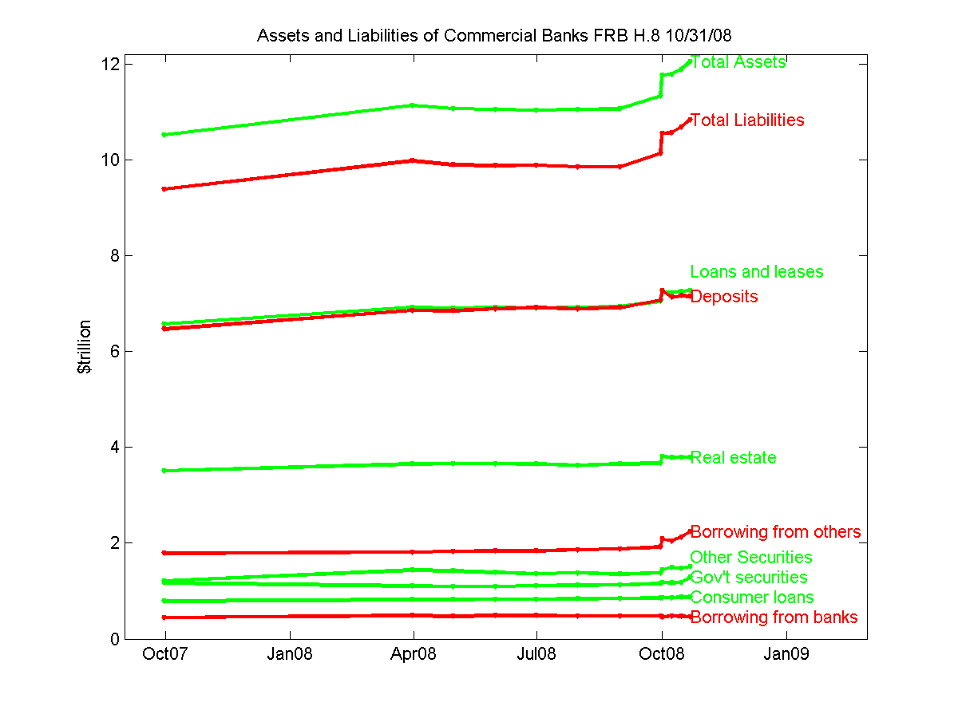

Slide 36
Firm | Writedown & Loss | Capital Raised
Citigroup Inc.* | 60.8 | 71.1
Wachovia Corporation* | 52.7 | 11
Merrill Lynch & Co. | 52.2 | 29.9
Washington Mutual Inc. | 45.6 | 12.1
UBS AG | 44.2 | 28
HSBC Holdings Plc | 27.4 | 5.1
Bank of America Corp. | 21.2 | 20.7
JPMorgan Chase & Co. | 18.8 | 19.7
Morgan Stanley* | 15.7 | 14.6
IKB Deutsche Industriebank AG | 14.8 | 12.2
Royal Bank of Scotland Group Plc | 14.1 | 23.1
Lehman Brothers Holdings Inc. | 13.8 | 13.9
Credit Suisse Group AG | 10.4 | 3
Deutsche Bank AG | 10.4 | 6.1
Wells Fargo & Company | 10 | 5.8
Credit Agricole S.A. | 8.8 | 8.5
Barclays Plc | 7.6 | 17.9
Canadian Imperial Bank of Commerce | 7.2 | 2.8
Fortis* | 7.1 | 23.1
Bayerische Landesbank | 6.9 | 0
HBOS Plc | 6.8 | 7.2
ING Groep N.V. | 6.7 | 4.6
Societe Generale | 6.6 | 9.4
Mizuho Financial Group Inc. | 6.1 | 0
National City Corp. | 5.4 | 8.9
Natixis | 5.3 | 11.8
Indymac Bancorp Inc | 4.9 | 0
Goldman Sachs Group Inc. | 4.9 | 10.6
…… | … | …
TOTAL | 590.8 | 434.2
Banks Can And Do Raise Capital!
(source: Bloomberg.com)

Slide 37
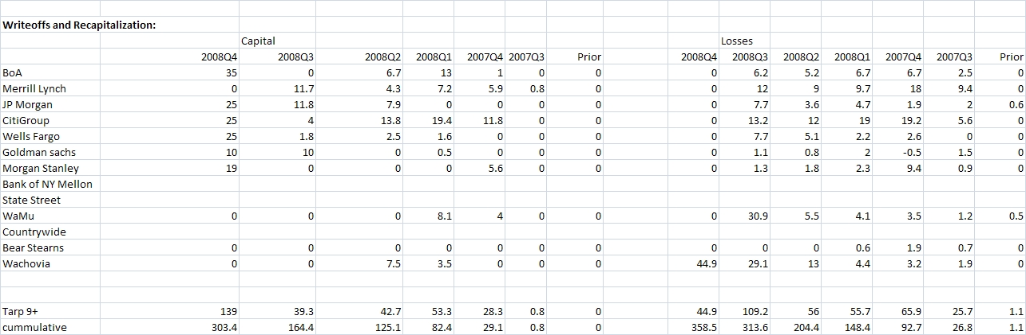
Banks Can and Do Raise Capital
Source :Anil Kashyap
Includes Treasury Purchase

Slide 38
Summary: Bank constraint vs. Credit market
Or risk premium view
r
r
Loan
Loan
Want to lend but can’t? Vs. no good borrowers, higher r?
Little decline in banking system lending.
Banks can and do raise equity.
Banks can and do fail / get taken over.
Treasury purchase/debt guarantee did not stop it in tracks.
“Recapitalized banks” pay dividends, buy other banks.
High risk premiums in nonfinancial, non-intermediated assets.
So…why is borrowing so much lower?

Slide 39
US Non-Agency MBS Issuance

Slide 40
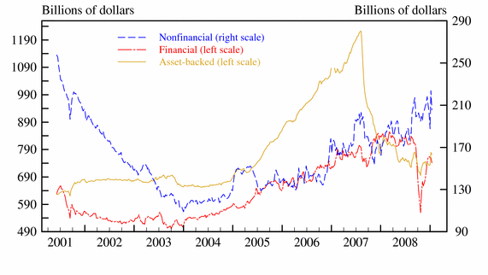

Slide 42
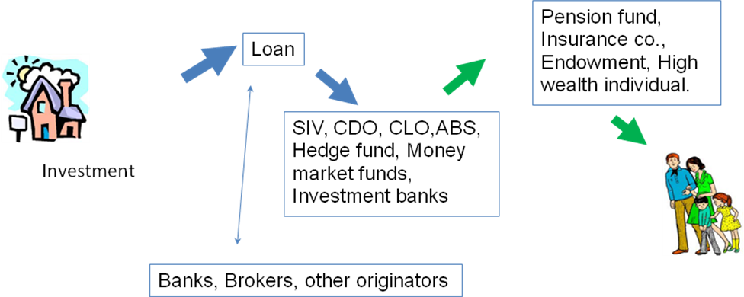
1930
.
2006:
2008

